Slide 1

WELLBOT – Global Wellness Assistant Chatbot
Team Members:
1. Meghana
2. Aishwarya
3. Akash Rawat
4. Gopichand
Under the Guidance of
Dr K. Santhiya

Slide 2



Introduction
Multilingual, AI-powered wellness chatbot providing reliable, non-diagnostic health and self-care information.
Combines conversational AI with personalized insights to support proactive wellbeing.
Improves accessibility, engagement, and awareness through simple, interactive guidance.
Aims to make trusted wellness information easily available to everyone.

Slide 3
Abstract
WellBot is an AI/ML-driven chatbot acting as a 24/7 wellness guide.
It consolidates advice on fitness, diet, sleep, and mental health into one interface.
Using NLP and Machine Learning, it provides context-aware recommendations.
The hybrid recommendation engine ensures personalized wellness guidance.
It bridges the gap between clinical expertise and daily self-care.

Slide 4
Problem statement
People often rely on scattered or unreliable online health information.
There is a need for a trusted, real-time wellness assistant that provides accurate, WHO-based guidance in a simple and accessible way.
Solution
WellBot provides a reliable, real-time wellness assistant that delivers verified WHO-based health information.
It offers instant guidance, simple explanations, and personalized support — all in one trusted platform.

Slide 5
Proposed System
The system integrates NLP and ML for multilingual, personalized health assistance.
A hybrid recommendation model delivers content based on user context and preferences.
It covers key wellness areas: nutrition, fitness, mental health, and sleep.
Data privacy and inclusivity are core principles for a global user base.
The architecture ensures scalability, engagement, and user trust.

Slide 6
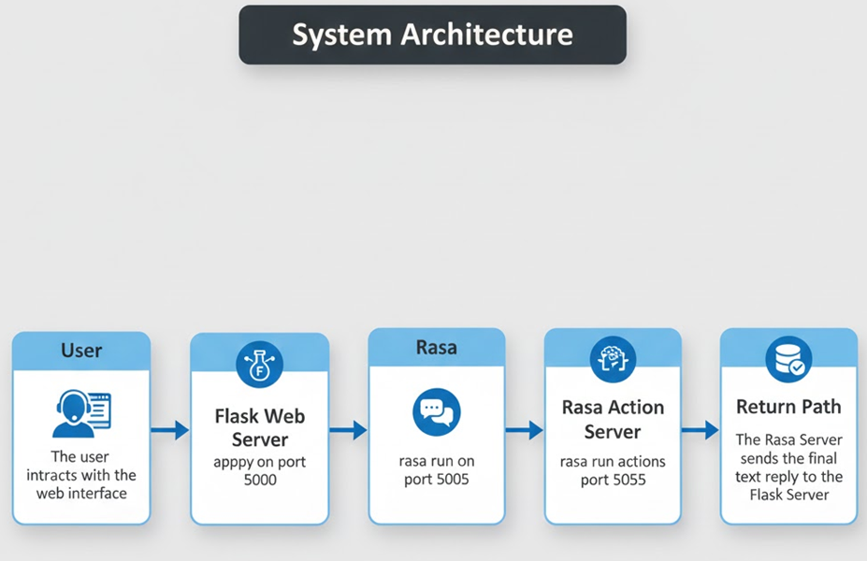
System Architecture

Slide 7
Milestone 1 – Authentication & Profiles
Built secure login, registration, and profile management using Flask & SQLAlchemy.
Implemented JWT-based authentication with encrypted passwords for strong protection.
Added frontend session validation to prevent unauthorized access.
Established a robust foundation for user-specific wellness personalization.

Slide 8
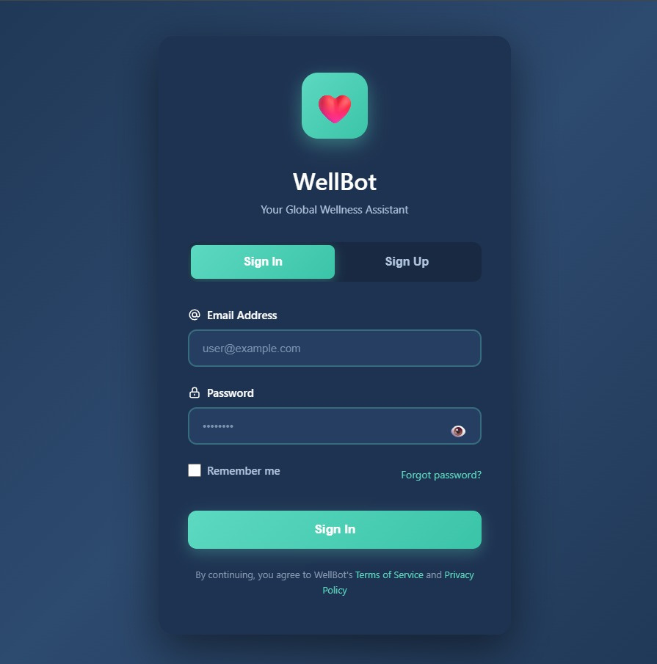
SIGN-UP Page:

Slide 9
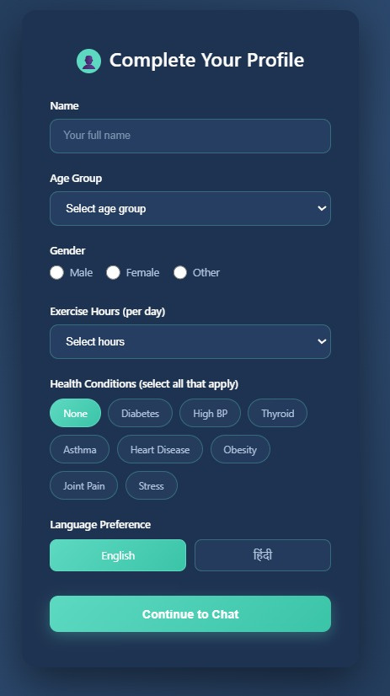
Profile Page:

Slide 10
Milestone 2 – Chatbot Integration & Web UI
Integrated Rasa chatbot with a Flask-based web UI for smooth interaction.
NLU model supports intent and entity detection in English and Hindi.
Multilingual HealthKnowledge database with easy CSV-based updates.
Custom Rasa actions dynamically retrieve and deliver relevant wellness information

Slide 11
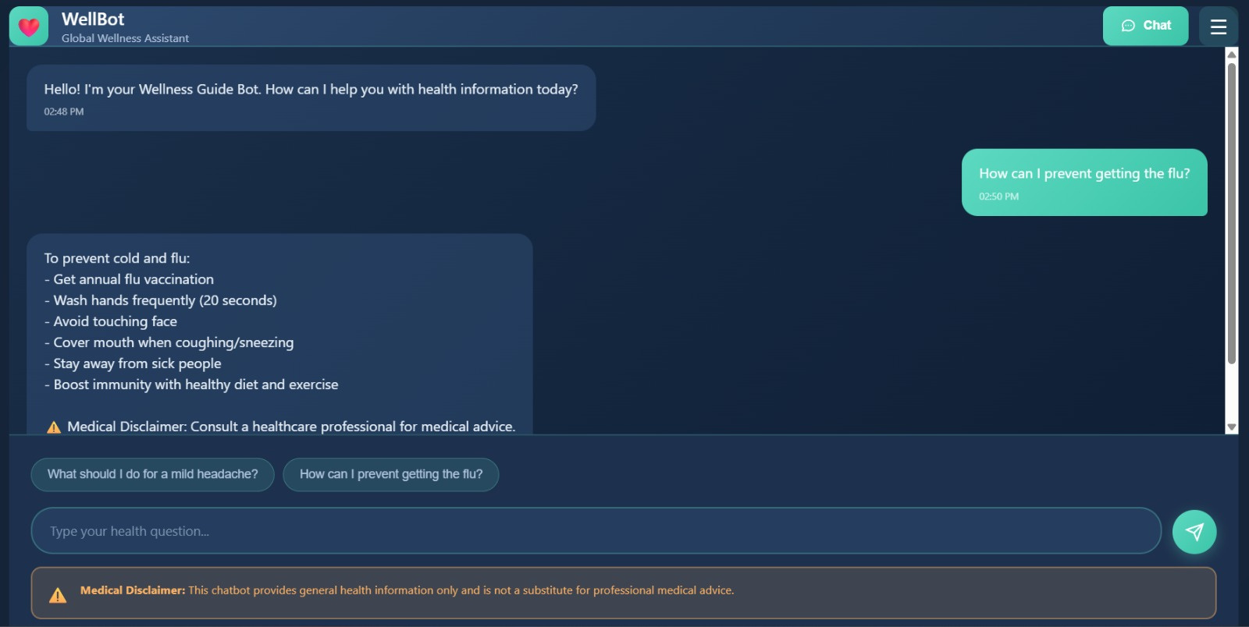
Chat User Interface:

Slide 12
Milestone 3 – Advanced NLP & Multilingual Features
Expanded the knowledge base to 100+ wellness topics with multilingual coverage.
Added safety disclaimers and clear medical boundaries for responsible use.
Introduced full Hindi support with dynamic language selection based on user preferences.
Enhanced NLU with improved entity extraction for more accurate, personalized responses.

Slide 13
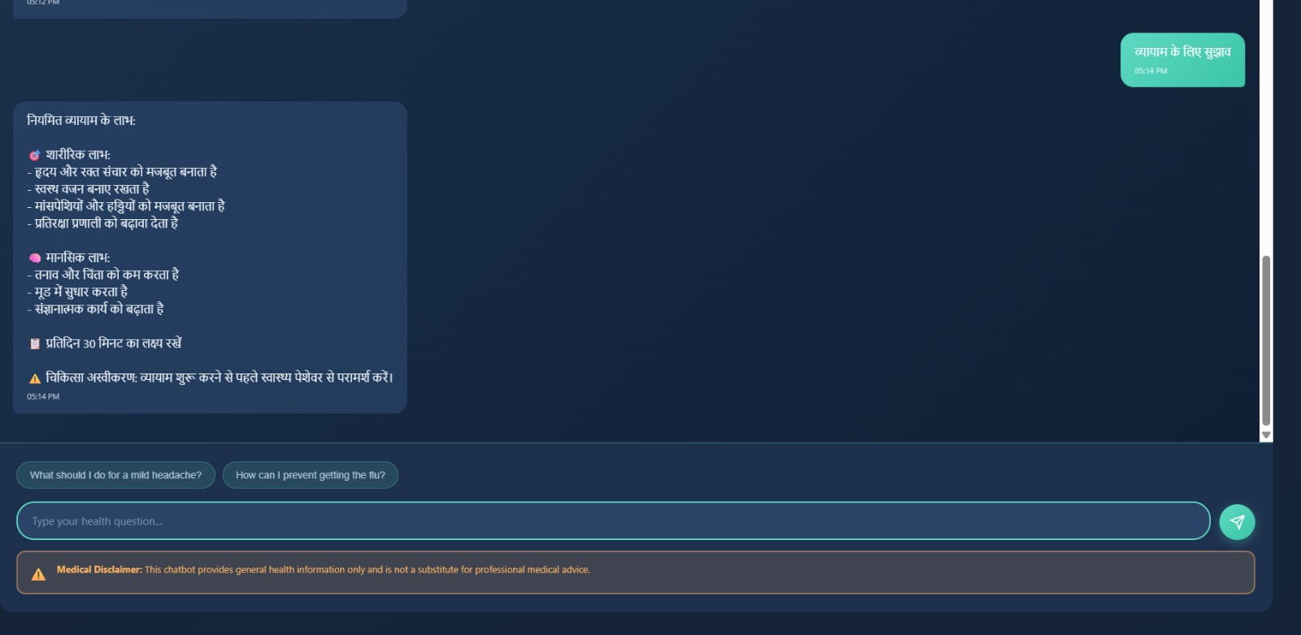
Chat User Interface in Hindi:

Slide 14
Milestone 4 – Admin Dashboard & Optimization
Built a secure admin dashboard for managing and updating knowledge-base entries.
Added user analytics and feedback tools (thumbs up/down) to monitor content quality.
Optimized backend sessions, logging, and error handling for smoother performance.
Redesigned the UI with a modern, responsive layout for better usability.

Slide 15
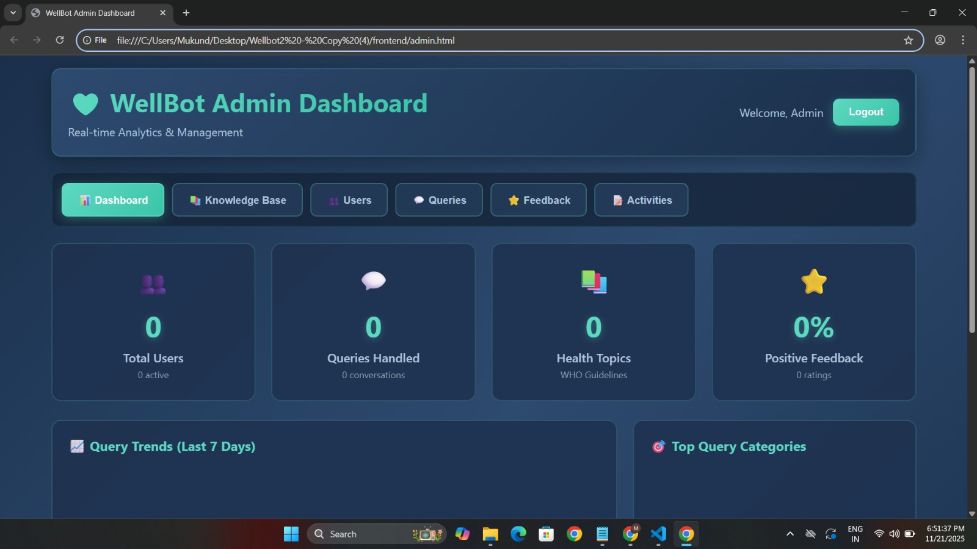
Admin Dashboard User Interface:

Slide 16
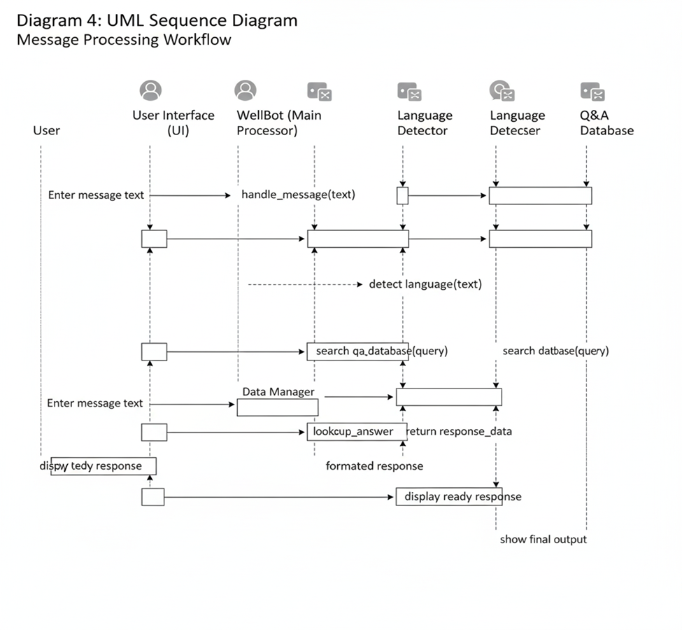
Sequence Diagram

Slide 17
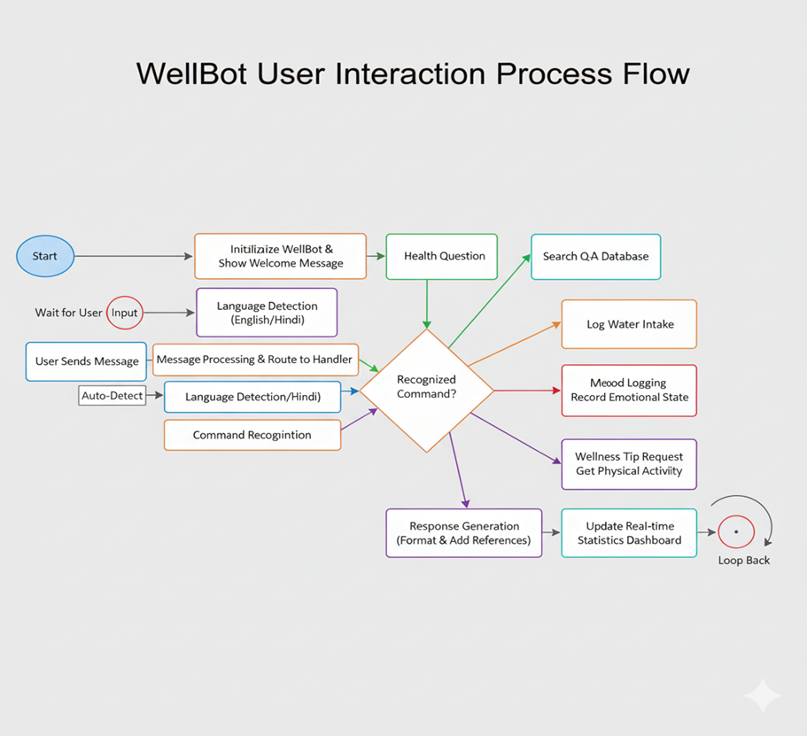
User Interaction Process Flow

Slide 18
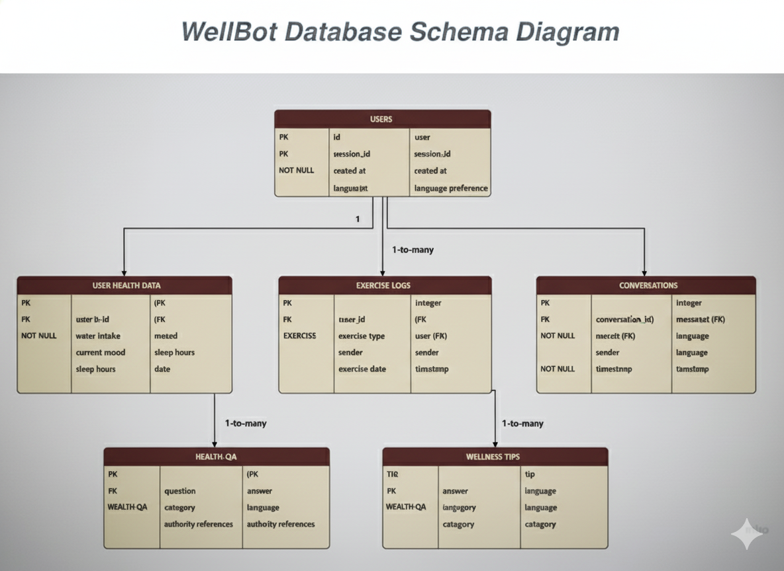


Database Schema Diagram

Slide 19
Technologies Used
Built on a modular open-source stack for scalability and reliability.
Backend: Flask (Python) for routing and API management.
AI Engine: Rasa for NLP, entity recognition, and dialogue control.
Authentication: Flask-JWT-Extended for token-based security.
Database: SQLite with SQLAlchemy ORM for smooth operations.
Frontend: HTML, CSS, JavaScript for interactive UI.
Ensures flexibility, modularity, and seamless integration.

Slide 20
Output – Expected Outcomes
Delivers personalized daily wellness plans (diet, fitness, sleep).
Provides stress and emotion-aware advice.
Increases engagement through intelligent interaction.
Scales globally with multilingual support and adaptive AI.

Slide 21
Future Scope
Introduce AR/VR meditation for immersive stress relief.
Enable AI-based image and voice diagnostics for early health checks.
Adopt blockchain for secure storage of sensitive health data.

Slide 22
Conclusion
WellBot demonstrates how AI can transform personal wellness.
It combines secure architecture with multilingual intelligence.
Supports self-care and awareness through accessible design.
Built with scalable, open-source technologies for growth.
Future versions will expand AI, security, and immersive health tools.

Slide 23
THANK YOU

